Slide 1

GAME PLAN: Making Sport Marketable through Public Relations
By
Ms. Nkechi Obi
CEO, Sport Nigeria LTD/GTE
Lagos NIPR Clinic
8th May 2025

Slide 2

Introduction
NOTE:
To change images on this slide, select a picture and delete it. Then click the Insert Picture icon
in the placeholder to insert your own image.
Sports = passion, pride, and potential
But passion alone doesn’t create industries
We need a game plan for visibility, investment, social and economic impact as well as growth
We need a rethink of how we see sports and how to turn that vision into results

Slide 3



The Global Sports Industry
Major Impact of Sport on World’s Economy
JOBS
Employment along the value chain of sports including construction which delivers 1:7 impact, manufacturing, pro-sports, media, technology etc.
FACILITIES
New sports facilities including stadiums and arenas for major events, community centres for mass participation, performance centres and educational institutes
Wealth Creation
REVENUE
Annual revenue generated through demand for sports good and services, direct and indirect contribution to the local economy of countries.
Revenue Generation
PARTICIPATION
Hundreds of millions of people engaging in sports through education, fitness and healthy lifestyle, leading to a less idle and productive society.
INVESTMENT
Private sector investment in sports infrastructure, professional leagues and teams, manufacturing, e-commerce, events and both traditional and digital media.
Job Creation

Slide 4
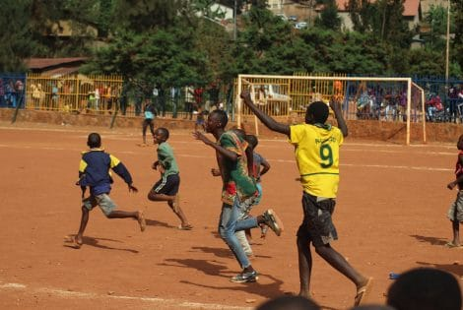
The Reality Check –
Where Nigeria Stands
NOTE:
To change images on this slide, select a picture and delete it. Then click the Insert Picture icon
in the placeholder to insert your own image.
Huge Infrastructure gaps
Limited funding & private sector engagement
Fragmented narratives
Weak economic understanding of sports

Slide 5





Sports – The Untapped Opportunity
Current industry Market Size of NGN 500+bn
Estimated Annual investment required over the next 10 years - $1 Billion
Estimated Annual Revenue over the next 10 years – $4 Billion
Contribute 2–3% to Nigeria’s GDP
Create 3–5 million jobs in 10 years
Tap into a 300–500 million African market for goods and services
A population of >200 Million
65% population between 15 and 35 years
A young population Passionate about sport
Mobile penetration of >154 Million
TV and media audience between 40 and 70 million
* Source – National Sports Industry Policy 2022-2026

Slide 6
Sports – A Nation’s Brand and Business Asset
Sports
The ultimate tool for connecting people, with the power to unite in a way that little else does.
The economic impact of sport also delivers billions of dollars in revenue globally through the consumption of sports goods and services.
NO OTHER ASSET CLASS globally delivers both social and economic value on the scale that sports does. This makes sports one of the MOST VALUABLE ASSET CLASSES in the world.
Sports as soft power that tells Nigeria's story, Drives Economic Activity such as tourism, youth development, health and innovation, while Redefining Nigeria’s international reputation

Slide 7
Sports – The Repositioning Framework
Policy Basis
Recategorise Sports
Policy Strategy
3Is & 1P Industry Developement
Policy Impact
Shift focus from purely participatory to business and industry – public sector led, private sector driven
Key Outcome
Enable organisations like Sport Nigeria to be developed – interface between stakeholder groups to develop the industry
Incentives and Investment for development
Industrialization, Revenue Generation, and Economic Contribution
Athletes Development and Welfare Retention
Inclusivity and Sustainability

Slide 8

The Game Plan -
Strategic PR & The Sports Industry
NOTE:
To change images on this slide, select a picture and delete it. Then click the Insert Picture icon
in the placeholder to insert your own image.
Reframe: From 'entertainment' to 'enterprise’
Engage: Investors, government, DFIs, brands
Leverage: Train media to tell sports stories with an economic slant
Influence: Use PR for policy, investment and incentives

Slide 9
PR Framework for Sports Growth
Audit – Assess current narratives
Message – Tailored to each audience
Create – Long-term PR campaigns
Collaborate – Journalists, influencers, brands
Measure – Track impact and visibility

Slide 10

Case Study 1 –
AFCON 2024
NOTE:
To change images on this slide, select a picture and delete it. Then click the Insert Picture icon
in the placeholder to insert your own image.
Unprecedented Global Reach - 2.2 billion global viewers – more than the Super Bowl
3.1B TikTok views
2.1B digital interactions
Broadcast in 180+ countries (BBC, beIN, Sky Sports, etc.)
CAF commercial revenue grew 65%, TV revenue up 35%
✅ Strategic PR positioned AFCON as a premium global event.

Slide 11

Case Study 2 –
Basketball Africa League
NOTE:
To change images on this slide, select a picture and delete it. Then click the Insert Picture icon
in the placeholder to insert your own image.
1.6 million live viewers
238,000 watch hours
Broadcast in 214 countries, 17 languages
80,000+ in-person attendance
125,000 peak livestream viewers
✅ BAL used PR to showcase Africa's basketball potential and commercial growth.

Slide 12

Case Study 3 –
Remo Stars FC
NOTE:
To change images on this slide, select a picture and delete it. Then click the Insert Picture icon
in the placeholder to insert your own image.
Digital Transformation in Nigerian Football
126,500 followers (Top 3 NPFL team online)
1.3M impressions, 726K reach, 91K views in 30 days
Highly engaging content with 34K reach, 12K+ clicks on a single post
✅ PR and content marketing rebranded Remo Stars as a digital-first club.

Slide 13

Case Study 4 –
Sports Africa Investment Summit
NOTE:
To change images on this slide, select a picture and delete it. Then click the Insert Picture icon
in the placeholder to insert your own image.
350+ delegates from 10+ countries
Stakeholders from across sports ancillary sectors – construction, real estate, investment, finance, manufacturing, public sector, athletes, events, legal, etc.
Partners: Afreximbank, UNESCO, NSC, BoI, AfDB, AU6RG
Projects: SSEZ in Abia, Spaces 4 Sports (S4S)
Amplified by strategic PR and communication

Slide 14
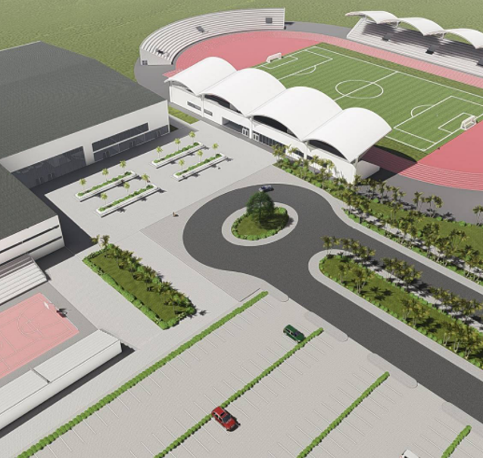
Conclusion
NOTE:
To change images on this slide, select a picture and delete it. Then click the Insert Picture icon
in the placeholder to insert your own image.
Sports is a business AND national opportunity
The Sports Industry is huge and a game changer for the economy
Professional services are the bedrock of successful industry development
Several ancillary sectors support the huge sports industry, including PR
PR should position as a playmaker, not a support act
With the right narrative, drive the on going change in the industry
“If sports is the next frontier, PR should be its compass.”

Slide 15
Let’s shape the future of Nigeria’s Sports Industry — Together!!
Thank You

