Slide 1

Rethinking Leadership Style and Mindset for Effective
Public Relations Campaign
Oludare Ogunyombo, PhD, MNIPR
Principal partner, D’intel Pearls services Nigeria limited
A paper presented at the monthly pr clinic of the Nigerian Institute of Public Relations (NIPR), Lagos chapter, november, 2023

Slide 2

“Your power emanates from your people. If you abuse that power, trust erodes.” – Ken Jacobs, ACC, PCC, Jacobs Consulting & Executive Coaching.
“Find your complement, not your duplicate.” – Elise Mitchell, APR, Fellow PRSA, CEO of Mitchell Communications and Dentsu Aegis Public Relations Network.
“Legacy will be determined by what you gave, not by what you gained.” – Tom Hoog, Fellow PRSA, vice chairman, H+K Strategies.

Slide 3

Leadership has emerged as a major area of concern on a global scale. In many instances, the dynamics of organizational structure and culture have reflected gaps between leadership and followership. Often, this situation has been traced to the leadership style existing in an organisation.
Sometimes it seems impossible to get your team members to share your perspective.
No company is exempted from this situation.
BUT YOU CAN ATTEMPT TO BE DIFFERENT BY WORKING ON YOUR MIND SET.

Slide 4
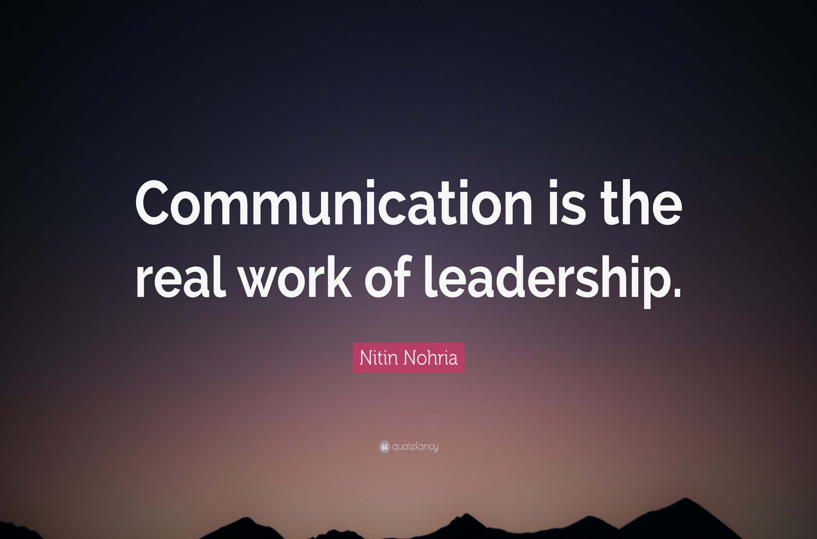

Slide 5
Leadership is communication which positively influence members of a group to move toward set goals.
Leadership is different from management because it relies on a social influence process rather than legitimate power to influence people.
Leaders are able to influence moods, develop fresh approaches and create excitement at work.

Slide 6

Leadership is all about getting people to work together, to make things that might not ordinarily occur happen or to prevent things that would ordinarily occur from happening.

Slide 7

For leaders to be adjudged as positive in their style they must:
-identify themselves with their organisation,
-internalize the organisation’s values,
-be motivated to achieve the organisation’s objectives,
…these can only be achieved with the right mindset..

Slide 8
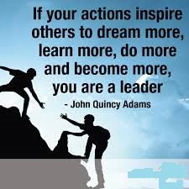
LEADERSHIP CHECK
Ask yourself:
What kind of leader am I?
Am I very transactional in my approach?
Does my style tend towards transformational leadership?
Do I have both traits?

Slide 9
LEADERSHIP BAROMETER (Exercise)
TYPE “A” LEADERS’ TRAITS:
- I reward employees who behave in the manners I want and punish those who do not;
- I am pragmatic and take all realistic constraints and opportunities into account;
- I just want things to remain the way they are;
- I dread when my subordinates decide to do things differently;
- I reward based on the achievement of set targets;
- I am happy to work within the existing systems and constraints and do not bother thinking outside the box;
- I prefer to handle matters when they arise;
- I advocate for strict adherence to hierarchy and the corporate structure and culture.

Slide 10
LEADERSHIP BAROMETER
TYPE “B” LEADERS’ TRAITS:
- I reward my subordinates based on teams achievement and not necessarily what I want to be done;
- I do not discourage my subordinates to challenge my line of thought;
- I do not discourage my subordinates from challenging the status quo;
- I regularly take inputs from my subordinates when I am to make a high risk decision;
- I aim for consistent innovation no matter how ‘stupid’ it may sound;
- I prefer to address issues as they arise, I do not wait;
- I prefer to treat my team members as heroes even when I have favourites among them.

Slide 11

TYPE A
Transactional Leadership: promotes compliance with existing organizational goals and performance expectations through supervision and the use of rewards and punishments. Transactional leaders are task- and outcome-oriented.
This strategy maintains the status quo and uses a type of management that pays great attention to how personnel carry out their duties. It is particularly effective in projects with high project specifications, tight time and resource restrictions, and both.

Slide 12

TYPE B
Transformational Leadership: focuses on increasing employee motivation and engagement and attempts to link employees’ sense of self with organizational values. This leadership style emphasizes leading by example, so followers can identify with the leader’s vision and values.
A transformational approach focuses on individual strengths and weaknesses of employees and on enhancing their capabilities and their commitment to organizational goals, often by seeking their buy-in for decisions.

Slide 13

FACT:
WE ALL HAVE ELEMENTS OF BOTH TRAITS AS LEADERS BECAUSE THEY ARE NOT MUTUALLY EXCLUSIVE AND MAY BE SITUATIONAL.

Slide 14
CONCEPT OF MINDSET IN LEADERSHIP
“With the right mindset, we can’t lose, we either practice what we’ve learned or we learn what we need to practice.”
– NOURA, PHILOSOPHER AND MINDFULNESS AUTHOR

Slide 15

LEADERSHIP AND THE MINDSET
One of the best indicators of success and one of the hardest things to measure is a leader's mindset.
Leadership takes place in the subtle changes that start in the leader's thoughts.
Our behaviours can be affected if we can change our mindset and adopt a different attitude in our leadership roles. And so, our actions might completely transform how we feel.

Slide 16
Leaders rely on a portfolio of approaches, ranging from serving no one to serving society.
Knowing the strengths and pitfalls of each mindset — and which ones you rely on most heavily — can help you create better teams and have a greater impact.

Slide 17

LEADERSHIP AND THE MINDSET- THE BIG FOUR
Growth Mindset
Employees are given confidence by a leader who coaches them. Such leaders provide their staff the freedom to select their own route to success and offer assistance along the way.
Both a coaching mindset and a growth mindset are based on the idea that people are resourceful and that a coach's role is to assist people to realize their potential rather than to give instructions to an employee.

Slide 18
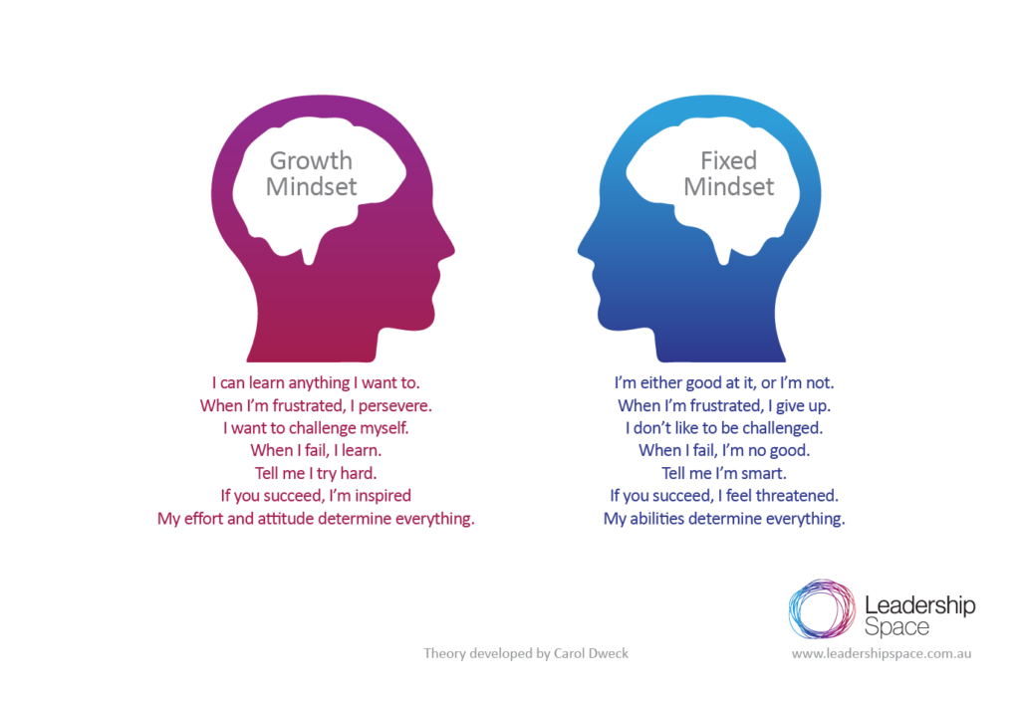
LEADERSHIP AND THE MINDSET- THE BIG FOUR

Slide 19

LEADERSHIP AND THE MINDSET- THE BIG FOUR
Inclusive Mindset
Inclusive leaders constantly solicit feedback from those who believe, look, or act differently from them.
They believe that it is important to go beyond self-reflection, exhibit the behaviours they want to see in their team and value the actions connected with soliciting input from others.
To accommodate those "unfamiliar" suggestions, an inclusive leader must first focus on reshaping his or her own thinking.

Slide 20

LEADERSHIP AND THE MINDSET- THE BIG FOUR
Agile Mindset
The capacity to adjust to workplace dynamics and obstacles as well as overcome them is one of an agile leader's most crucial skills.
Agile leaders are abandoning outdated procedures and practices in favor of fresh, creative ideas by becoming comfortable with the uncomfortable, and are always ready to push forward even when the details are sketchy.
Agile leaders are adaptable enough to modify or alter their plan in response to fresh facts or circumstances. They are not afraid of failure since they consider it as a necessary part of the process.

Slide 21

LEADERSHIP AND THE MINDSET- THE BIG FOUR
Enterprise Mindset
Leaders with an enterprise mindset give goals clarity and connect team success to organizational outcomes.
Leaders promote an enterprise attitude when they can fundamentally assist people in connecting their own and their team's work to organizational goals.
Employees can become stalled in routine tasks that occasionally feel unrelated to a bigger goal. Therefore, it is the responsibility of the leader to continually make those connections.

Slide 22
OTHER CONCEPTS OF MINDSET IN LEADERSHIP

Slide 23

LEADERSHIP AND THE MINDSET- THE PROBING SIX
The Sociopath Mindset
People that show a reckless disregard for anybody outside themselves exhibit the most constricting and dangerous attitude, known as the Sociopath.
Leaders who have a high concentration of this attitude often exhibit characteristics of antisocial personality disorder, such as lack of empathy and indifference to the emotional and physical suffering of others.
Additionally, they are frequently charismatic and very skilled at controlling other people and the organizational systems..

Slide 24

LEADERSHIP AND THE MINDSET- THE PROBING SIX
The Egoist Mindset
Egoistically oriented leaders are motivated by their personal desire to amass wealth, power, and status. Under this kind of leadership, an organization can develop and prosper—but only if its goals fall into line with the leader’s.
The culture of an organization can be completely destroyed by an excessively egoist mindset at the highest leadership level, though, unless these goals are balanced by other factors. Most times, collective activity and helpful actions, which are essential for an organization's long-term development, are neglected by an egoistic leader.

Slide 25

LEADERSHIP AND THE MINDSET- THE PROBING SIX
The Chameleon Mindset
Leaders with the Chameleon mindset are highly adaptive. Although they hardly ever become CEOs, they might advance within the company by winning over other powerful individuals. They frequently exhibit both poor self-esteem and a great drive to be liked. They frequently lack confidence and have trouble making difficult choices when opposed.
The organization's strategic initiatives can be advanced by those having strong Chameleon inclinations. However, don't be shocked if they suddenly start to support a new group of leaders.
People won't support leaders with strong Chameleon mindsets in battle since they don't behave with genuine conviction.

Slide 26

LEADERSHIP AND THE MINDSET- THE PROBING SIX
The Dynamo Mindset
People that have a dynamo mindset consistently and frequently execute strategy brilliantly. Leaders that possess this dominant mindset are idolized. They frequently complete significant projects on schedule, surpass their sales objectives, and make money.
They are excellent at organizing resources and other people's efforts. They are present at both junior and senior levels of every company and their coworkers depend on them.
However, those with a mainly Dynamo mindset also have a weakness. They risk losing sight of the bigger aim in their haste to accomplish anything.

Slide 27

LEADERSHIP AND THE MINDSET- THE PROBING SIX
The Builder Mindset
Leaders that primarily adopt a builder mindset advance the organization's overall well-being. This is not to mean that these leaders don't occasionally act in their own best interests, but, their main priority is the development of the company.
They manage for the long term rather than getting diverted by short-term profit and stock market valuations because they take into account the entire pie, not just their preferred slice.
For instance, the unit manager with a Builder mindset creates a comprehensive and long-lasting departmental vision that others desire to adopt.

Slide 28

LEADERSHIP AND THE MINDSET- THE PROBING SIX
The Transcender Mindset
People with a transcender mindset have even broader perspectives. They work from wherever they are to optimize value for numerous stakeholders both inside and outside the firm.
They serve as a link between disparate parties and recast the organization's mission and objectives in terms of social good. Strong transcender personalities are able to recognize the connections between seemingly unrelated components of a larger whole. They are competent at handling complexity.

Slide 29
Thinking about the right mix?

Slide 30
Although studies show that teams that produce more innovative solutions, and create more value for their organizations are those that have larger proportions of Dynamo, Builder, and Transcender in their portfolios, and lower proportions of Egoist, Chameleon, and Sociopath… the CHOICE IS ABSOLUTELY YOURS WHEN YOU THINK ABOUT HOW YOU WANT TO BE REMEMBERED AS A LEADER WHO ACHIEVED RESULT!!!

Slide 31
Success is a mindset. Let's learn how to create a positive one.
Beau Norton, Manifesting Abundance

Slide 32
THANK YOU FOR LISTENING
For clarifications call 08023878200; email: dareoguns2000@gmail.com

